Slide 1
Docker and Microsoft
Casey Watson
Technical Evangelist
cawatson@microsoft.com
@_caseywatson

Slide 2
Virtualization
Notes:
Briefly define virtualization
Virtualization is nothing new
Virtual machines/virtual memory
Virtualization is the foundation of the cloud
Virtualization granularity

Slide 3
Containers
Notes:
Containers bundle all of the components of an application – binaries, tools, dependencies, libraries, etc. – into one portable package.
Container technology is nothing new (FreeBSD Jails, Solaris Zones) but Docker has created a common toolset, packaging model and deployment mechanism that has made containers wildly popular.

Slide 4
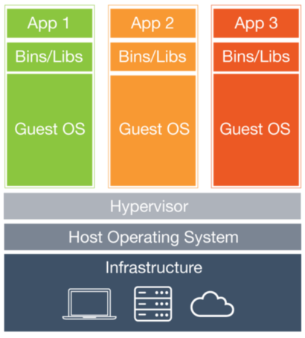
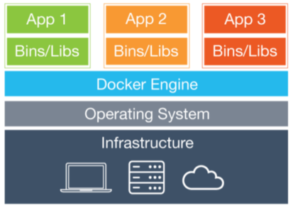
How is this any different than virtual machines?
Virtual machines
Containers

Slide 5
Why use containers?
Agility
Isolation
Compute density
Developer productivity

Slide 6
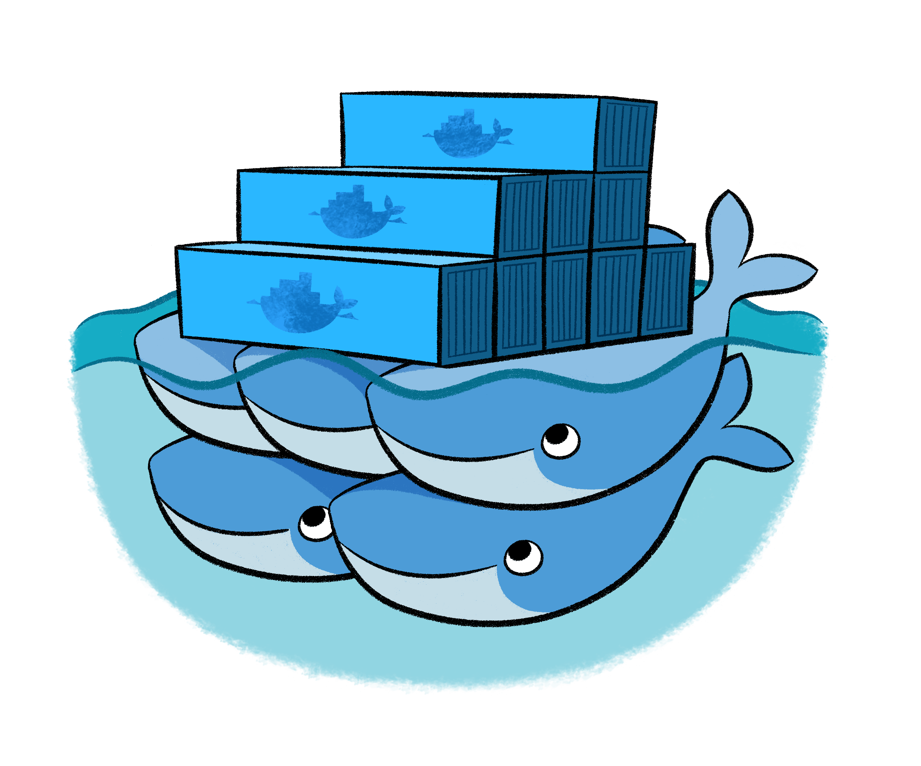
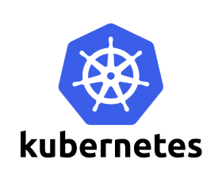


Orchestration

Slide 7
Docker

Slide 8
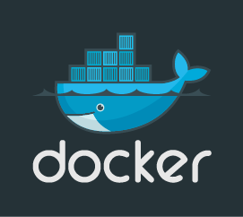
Docker
Launched in 2013
Common toolset, packaging model and deployment mechanism
Started the Open Container Initiative
Can run on any Linux platform and…
Now on Windows Server 2016!

Slide 9
Docker toolset
Docker Engine
Docker Client
Docker Hub
Docker Trusted Registry
Docker Machine
Docker Swarm
Docker Compose
Notes:
Docker Engine
Lightweight runtime that builds and runs Docker containers
Infrastructure and platform agnostic
Communicates with Docker Client
Docker Client
CLI used to manage Docker
Available on both Linux and Windows
Docker Hub
Hosts over 100K free applications, public and repositories
Cloud-hosted service that supports public and private repositories for Docker images
Supports automated Dockerfile builds from Github and Bitbucket, users and organization management, and webhooks
Official repositories are a curated set of Docker images that are digitally signed and maintained
Docker Trusted Registry
Store and manage Docker images on-premises
Configurable storage back-end and identity/RBAC (AD/LDAP)
Docker Machine
Automatically sets up Docker on your local computer, cloud provider or data center
Automatically provisions host, installs Docker Engine and configures Docker Client connection
Docker Swarm
Native clustering to turn a group of Docker engines into a single, virtual Docker engine
Basic scheduling + pluggable schedulers (Mesos, etc.)
Docker Compose
Microservices
Define multi-container application as a YML file and spin application up using a single command

Slide 10
Docker and Microsoft
Notes:
Microsoft has been working closely with Docker for over a year now making important open source contributions.
Much larger story: Microsoft and Linux
20% of VMs running in Azure are Linux
You can now deploy ASP.NET 5 applications to Linux
Create applications that have components hosted on Linux and Windows

Slide 11
Since the work started in November 2014, it has been and still remains quite unbelievable for us to interact with Microsoft on an Open Source project. And even if we confess a bit of skepticism in the early days, we have to admit now how impressed (and really, slightly overwhelmed) we have been by the pace of the Microsoft contributors…
Arnaud Porterie
Docker Senior Engineering Manager

Slide 12
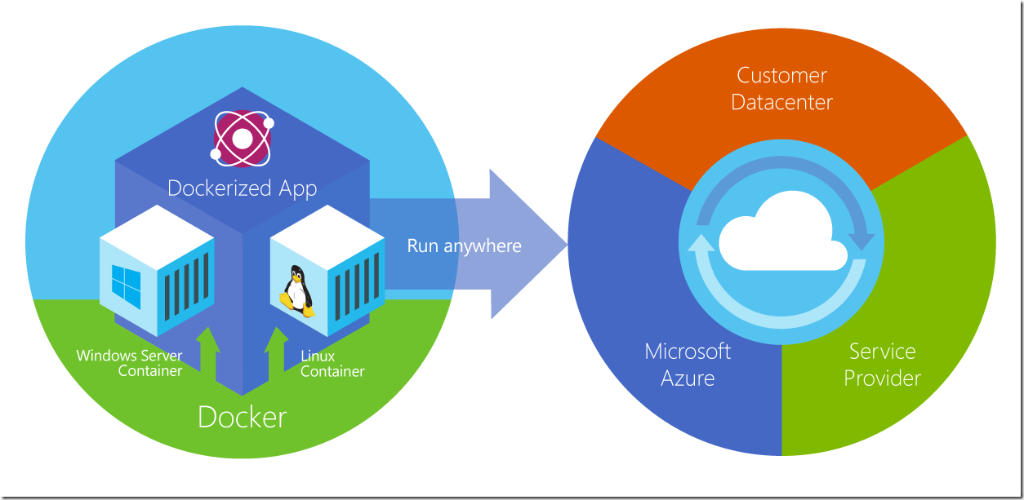
Notes:
The goal: Applications that consist of Windows and Linux based components that you can run anywhere

Slide 13

Docker and Microsoft Azure
Docker VM Extension for Linux
Azure Container Service
Azure Marketplace Integration
Docker Compose
Docker Machine
Docker Swarm
+
Notes:
Docker VM Extension for Linux
An extension to the Linux Agent that installs and configures the Docker Engine and can launch containers via Docker Compose.
Azure Container Service
Simplifies the creation and configuration of a cluster
Supports Docker and Docker Swarm by default
Pluggable architecture allows you to plug in Marathon, Chronos and Apache Mesos
Provisions hosts and containers
Driven by ARM templates
Azure Marketplace Integration
Setup hosts + containers though the Azure Marketplace
Curated Official Repositories from Docker Hub
Docker Compose
Working on ability to pass YAML directly to Azure to automatically spin up hosts/containers
Docker Machine
Spin up Docker hosts and Engines on a number of platforms with one command
Azure was one of the first platforms to be supported
Docker Swarm

Slide 14
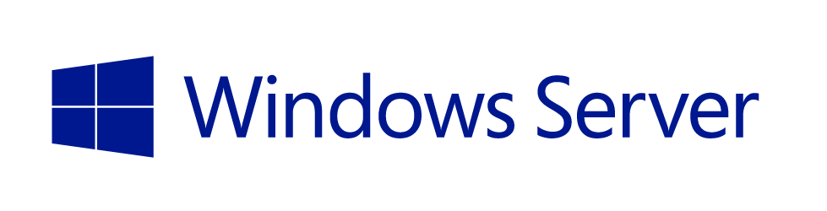
Docker and Windows
Windows Container Service on Windows Server 2016 TP3
Kernel-level changes made to support containers
Linux and Windows containers are not interchangeable
+
Notes:
Planned to release in early 2016

Slide 15
Windows container types
Windows container
Runs in dedicated user mode
Shares a common kernel
Optimized for compute density
Ideal for single-tenant environments
Hyper-V containers
Runs in a dedicated Hyper-V VM
Kernel isolation
Optimized for isolation
Ideal for multi-tenant environments
Not yet available
Notes:
Application is always packaged as a standard Windows container
At deployment time user is prompted to select container type

Slide 16
Demo
Working with Containers in Windows Server 2016 TP3
Deploying applications to Docker Containers with Visual Studio 2015

Slide 17
Q&A

Slide 18
Casey Watson
Technical Evangelist
cawatson@microsoft.com
@_caseywatson

